Slide 1
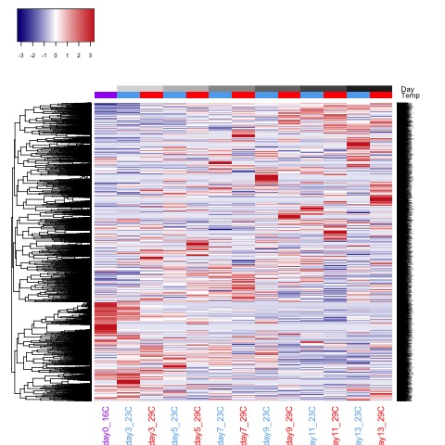
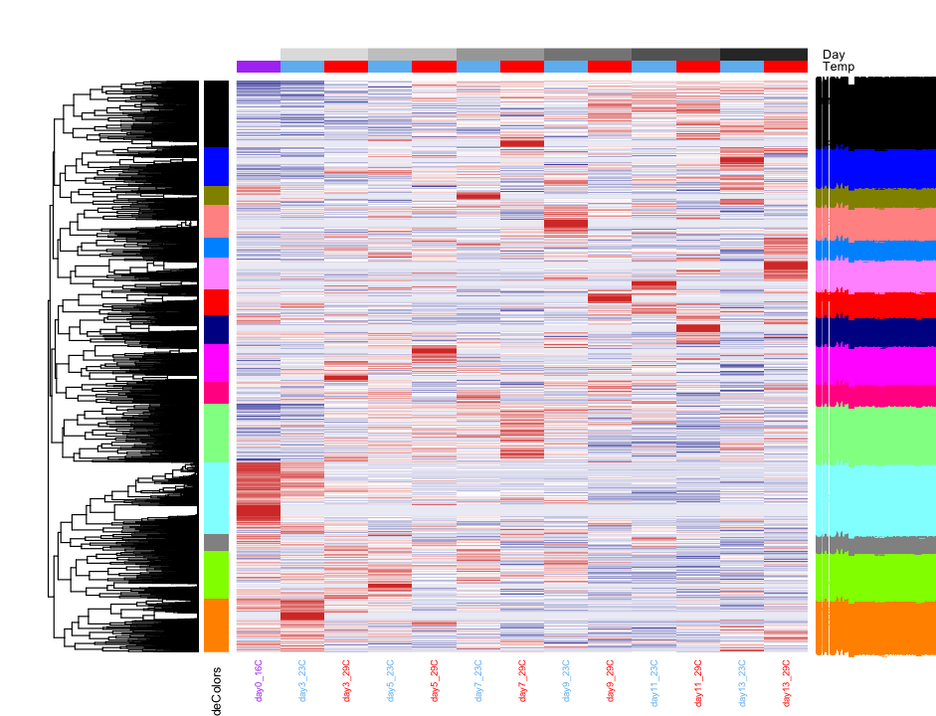
Complete clustering

Slide 2
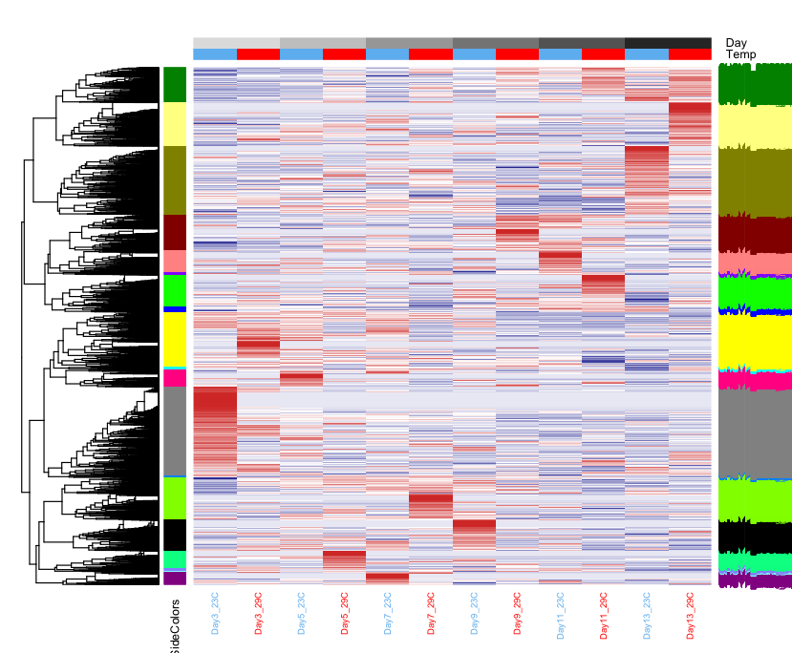
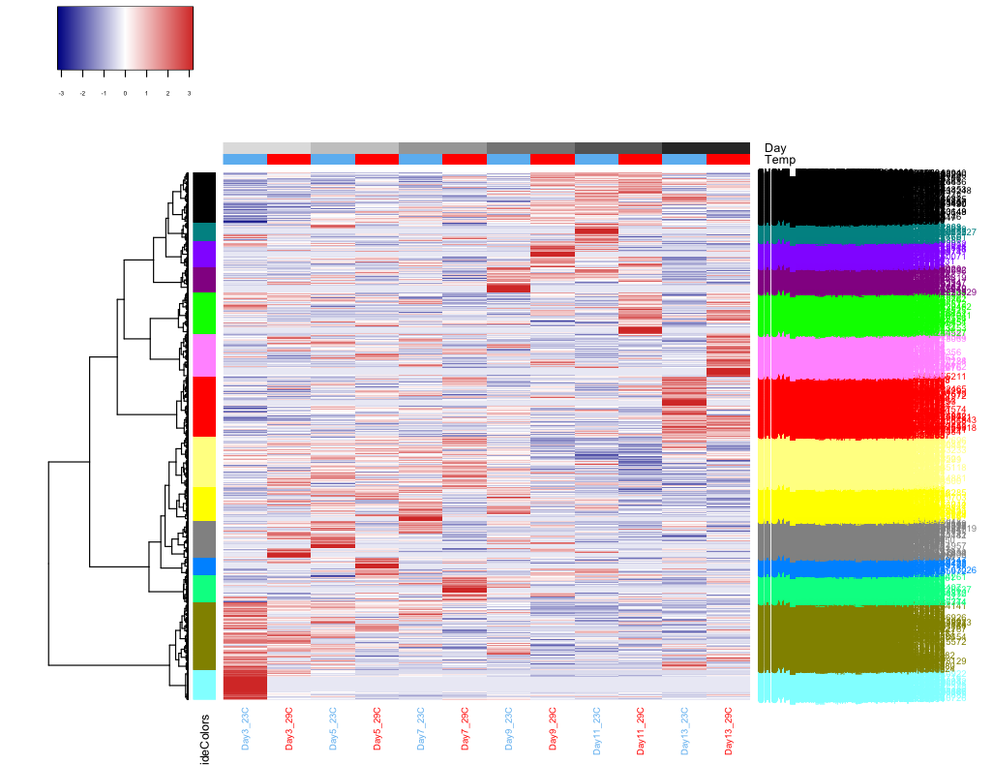
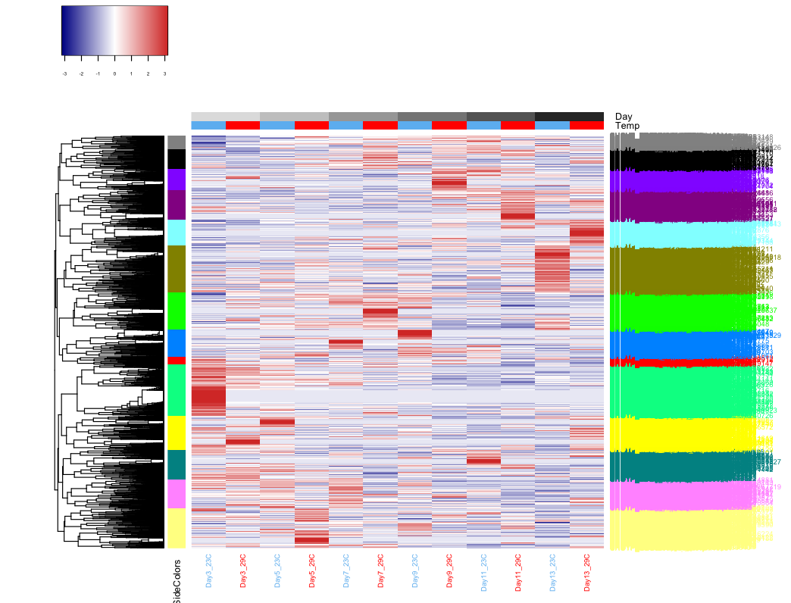
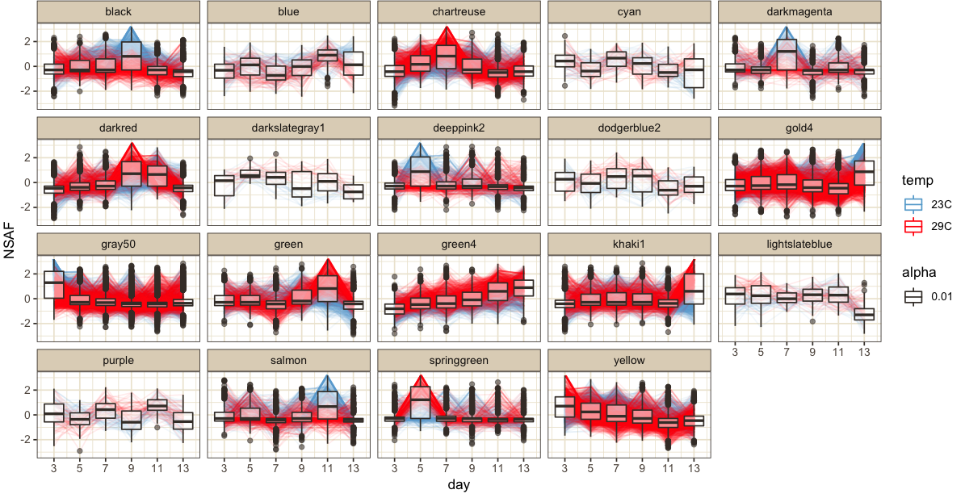
Different clustering methods without day 0
Average
Ward
complete
This might be interesting to plot boxplots for each different temperature to see if there is a difference
These are mean centered autoscaled NSAF values

Slide 3
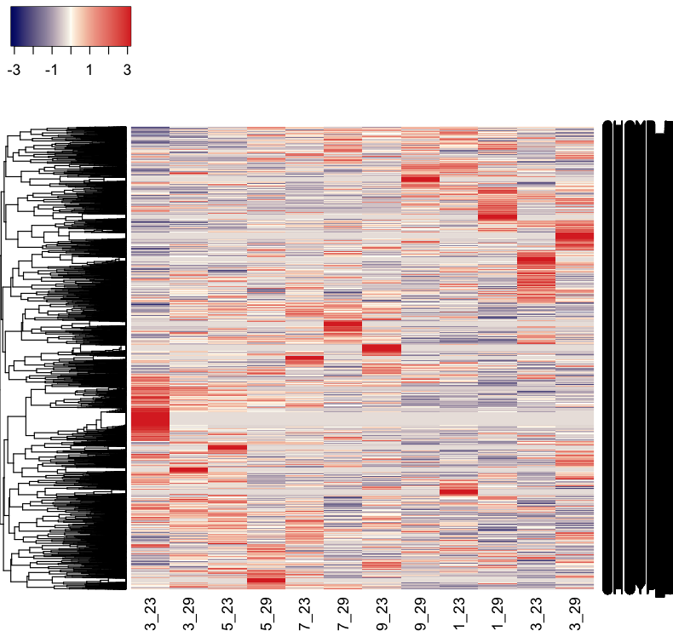
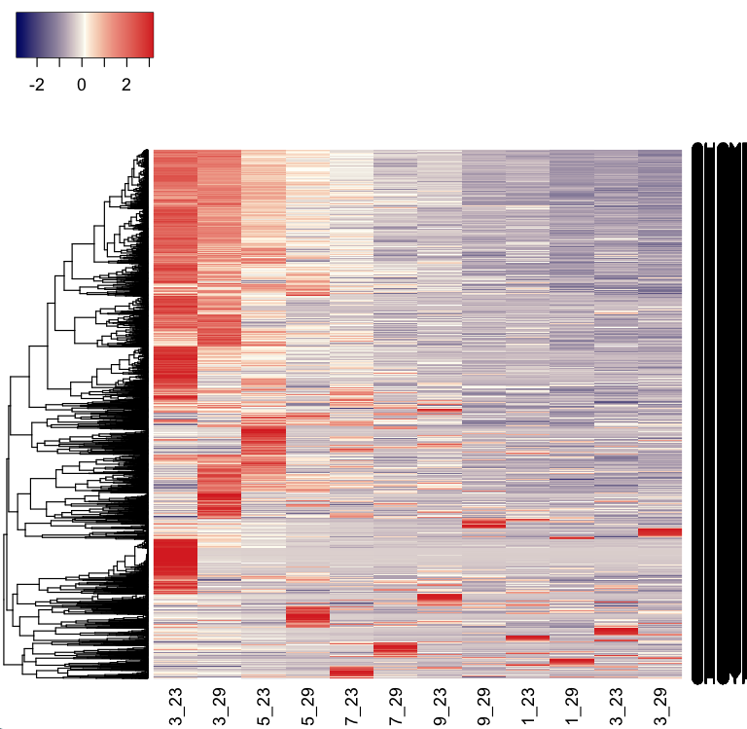
Proteomes normalized for day x temp
***some proteins show expression patterns that are

Slide 4
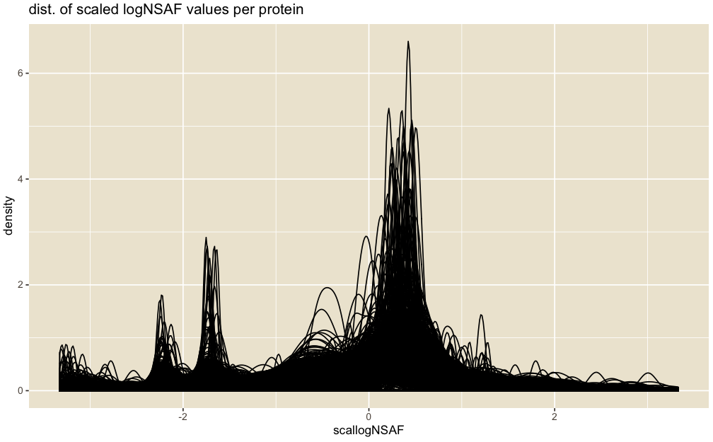
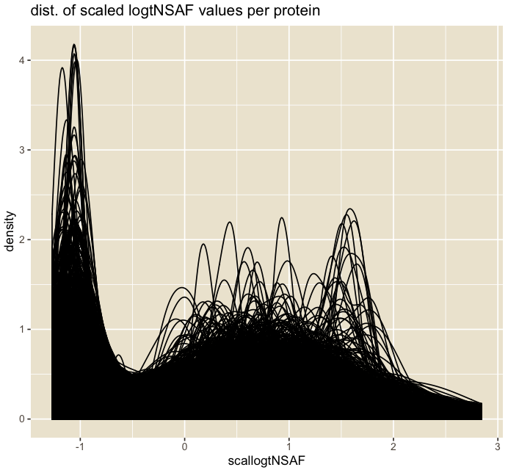
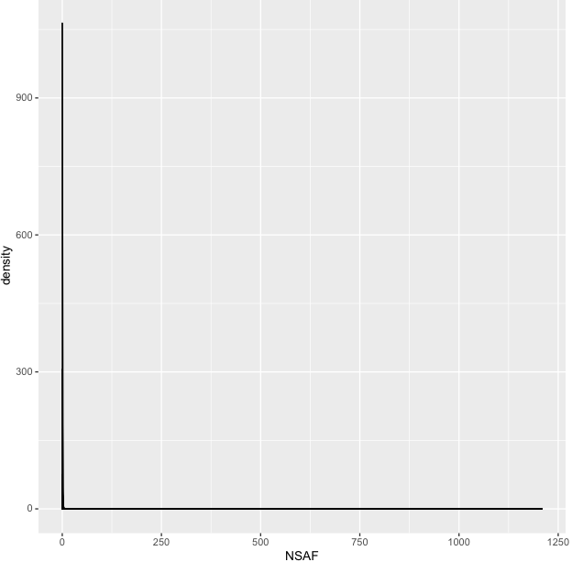
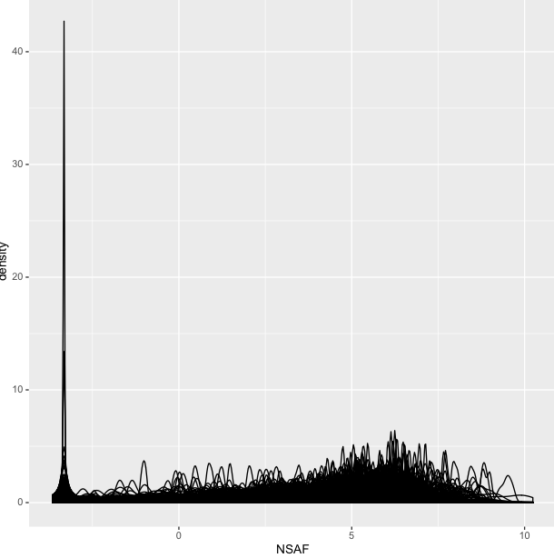
Transform data before running ASCA???
Density plots of NSAF values, each line is a different protein
NSAF
Log NSAF
This one looks closest to normal
It’s autoscaled by protein
This one looks closest to normal
It’s autoscaled by sample
Notes:
***See General Proteome Characterization rproject and NSAFBIgHeatmap_GOsemsimHeatmap.Rmd

Slide 5
Enrichment vs. pathway analysis
Enrichment = which biological processes are significantly overrepresented by expressed proteins
Could also be based on significantly expressed (>= 2x at a given time)
***independent of protein abundance
pathway analysis = pathways likely affected by change in protein abundance
***We don’t really know how the up and down of the proteins affect the process
Except if GO BP is neg regulation or positive reg
Example: 5 proteins are involved in BP term ‘negative regulation of cell growth’
@ 23C, their sum NSAF is 10
@29C, their sum NSAF is 1
We can conclude 23C has INCREASED negative regulation of cell growth compared to 29C because proteins related to that BP have increased abundance

Slide 6
ADJNSAF values
Known contaminants
Log₂ ADJNSAF values
Known contaminants

Slide 7
a
d
PC1 vs PC2 for temperature factor
relative NSAF values
23ºC
29ºC
protein
b
PC2 Loadings
0.025
c
protein
-0.025
PC2 Loadings
protein

Slide 10
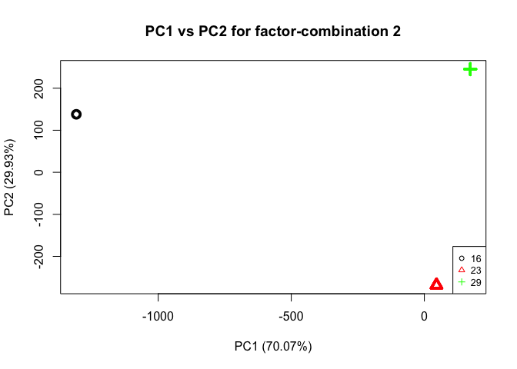
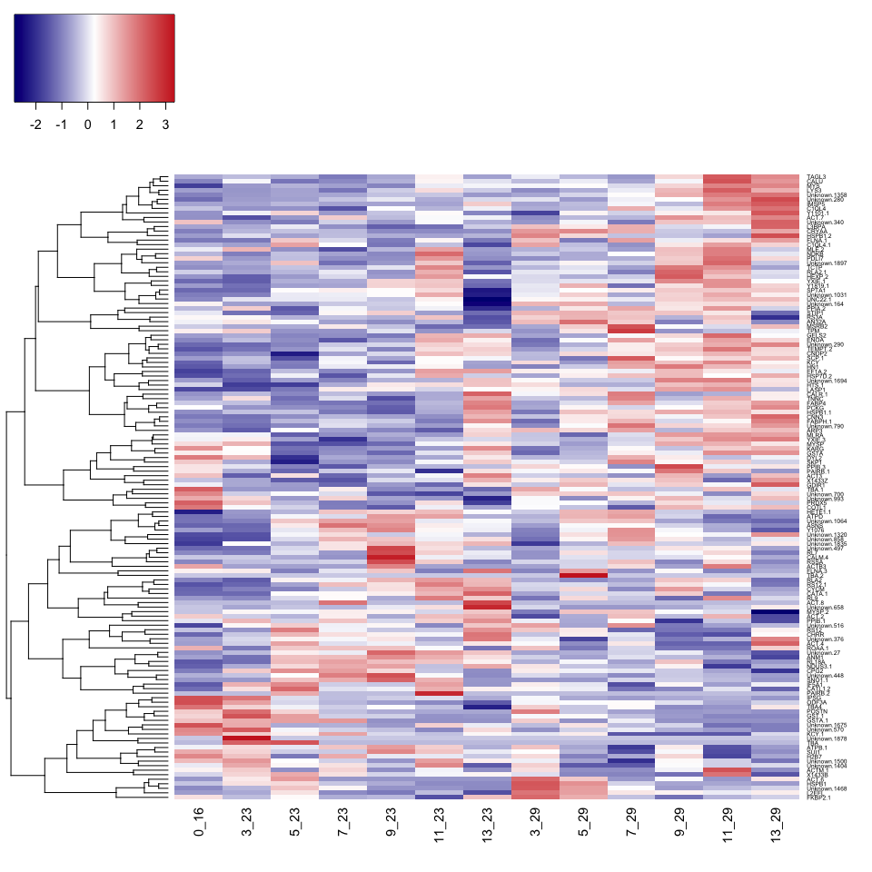
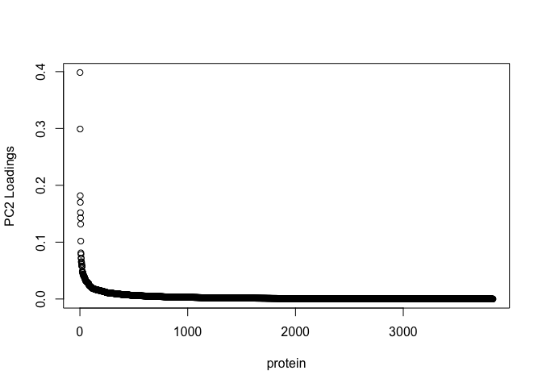
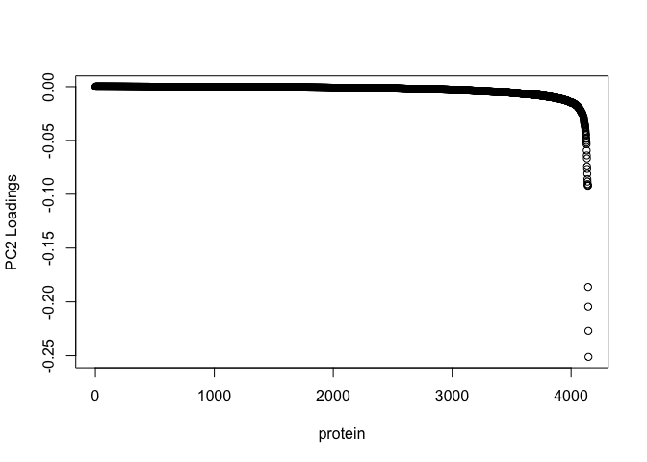
Proteins affected by temperature
relative NSAF values
23ºC
29ºC
protein
Temp.
PC2 loadings
-0.025
0.025

Slide 11
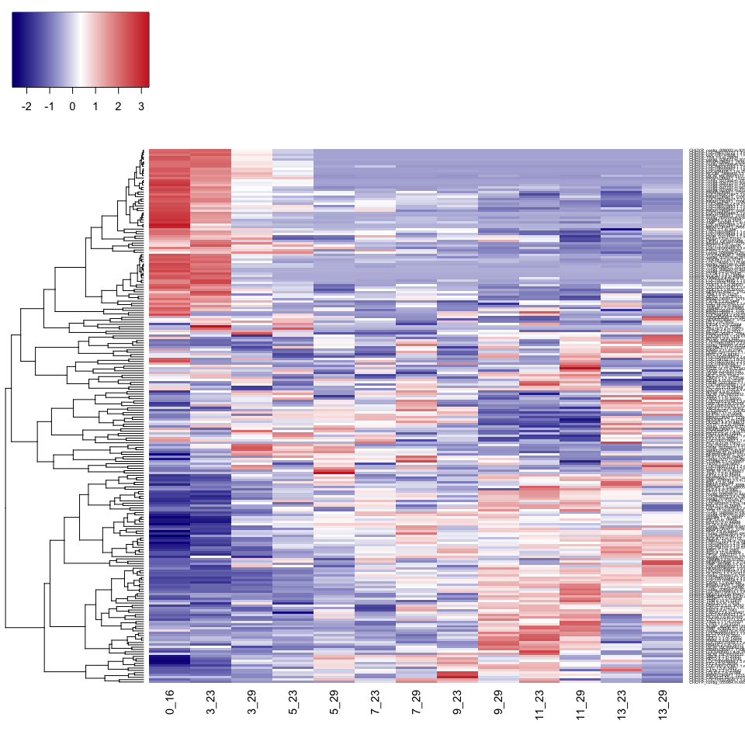
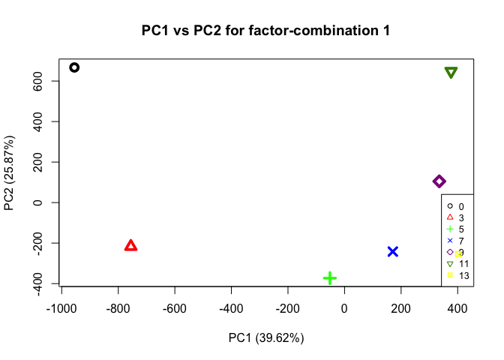
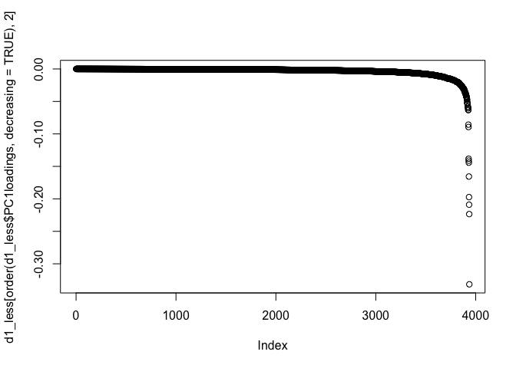
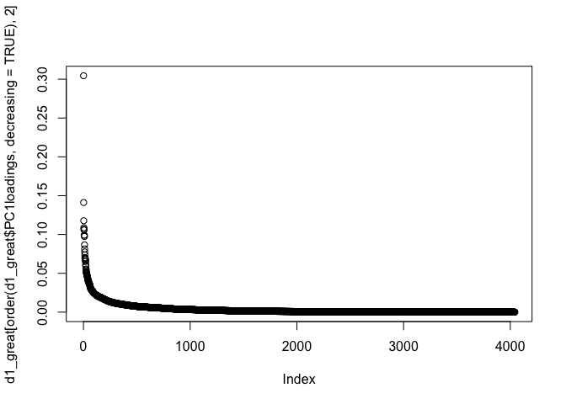
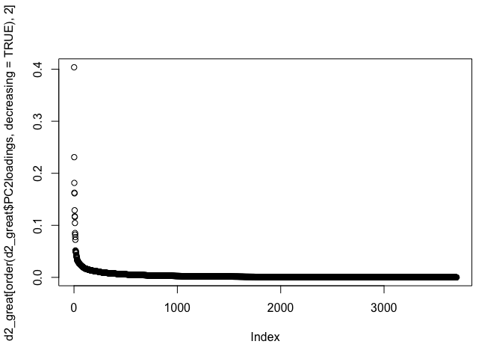
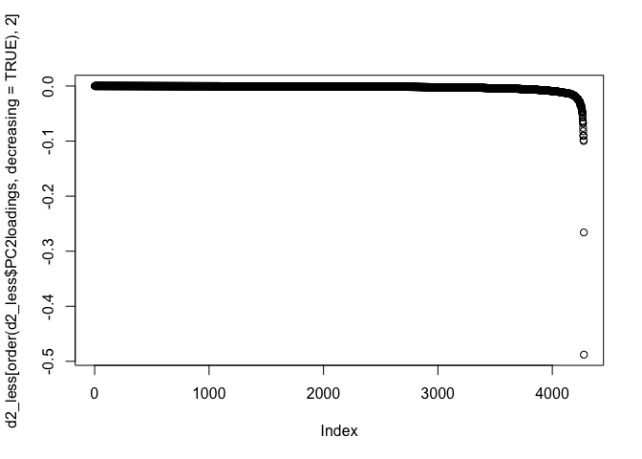
Proteins affected by time
relative NSAF values
Days
0
3
5
7
9
11
13
protein
PC1 loadings
-0.025
0.025
PC2 loadings
-0.025
0.025

Slide 12
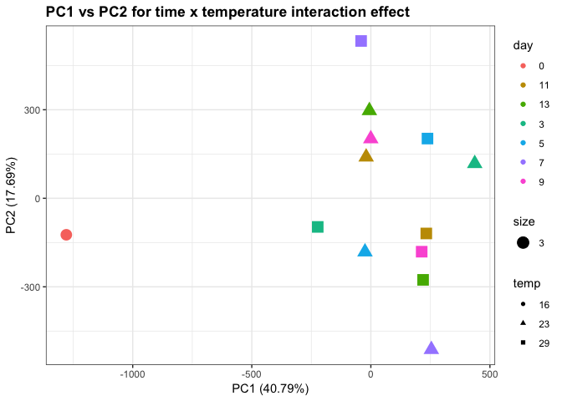
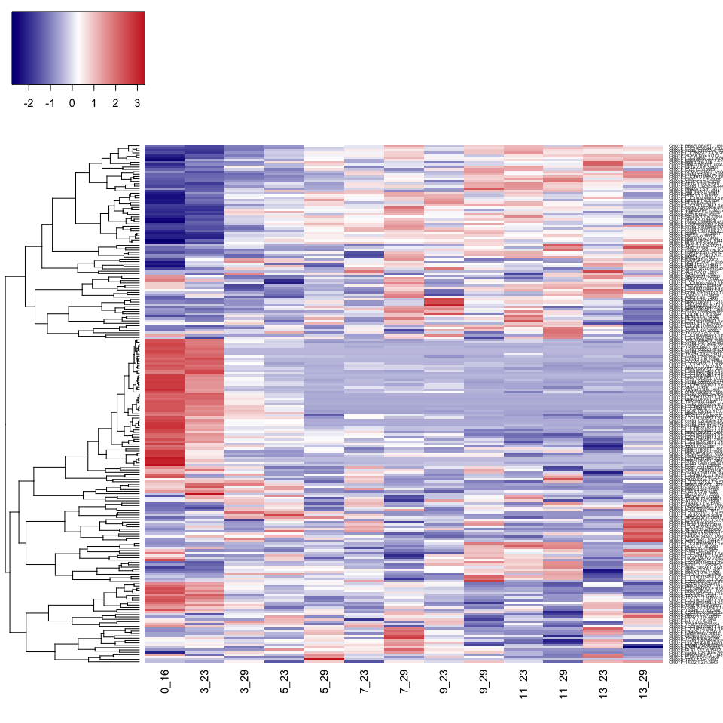
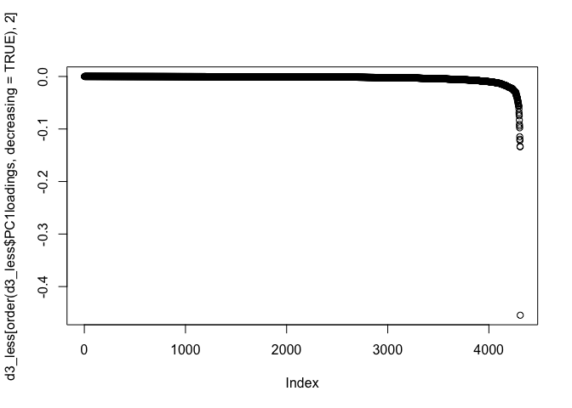
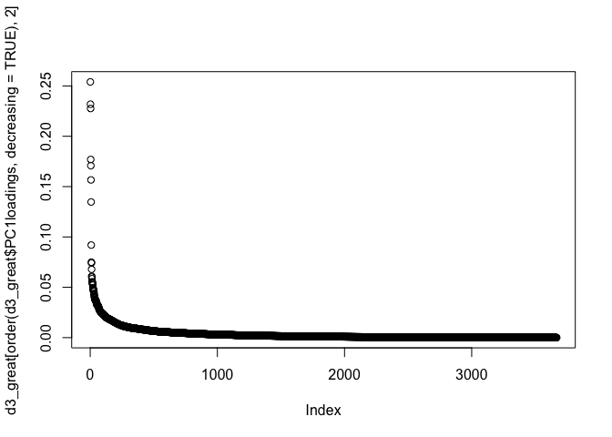
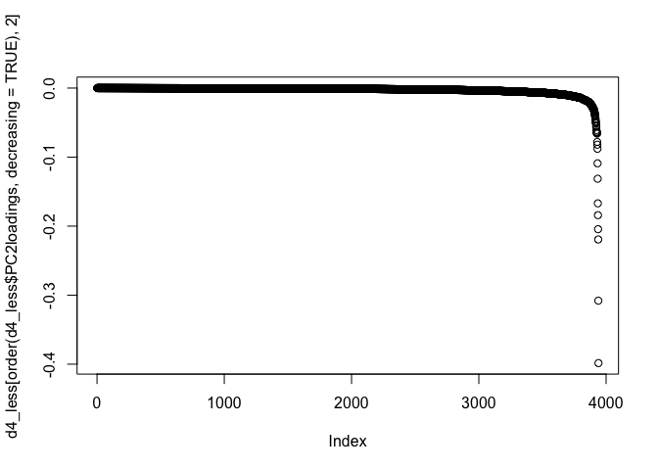

Proteins affected by time x temperature interaction
relative NSAF values
Days
0
3
5
7
9
11
13
protein
PC1 loadings
-0.025
0.025
PC2 loadings
-0.025
0.025

Slide 13
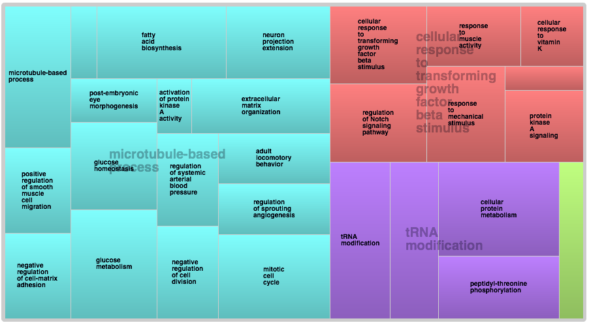
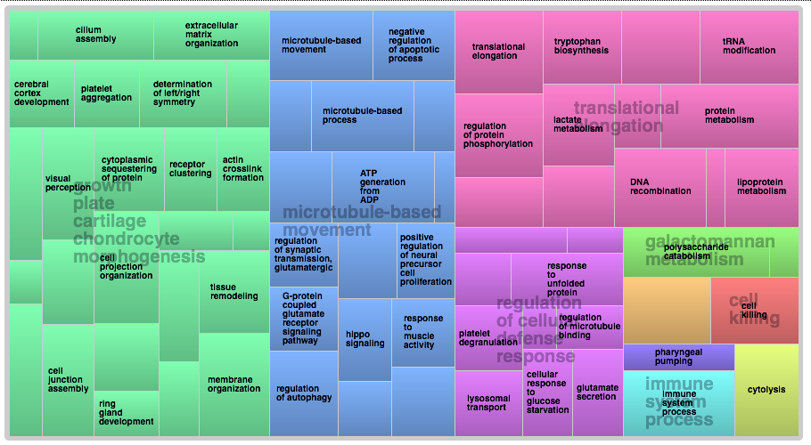
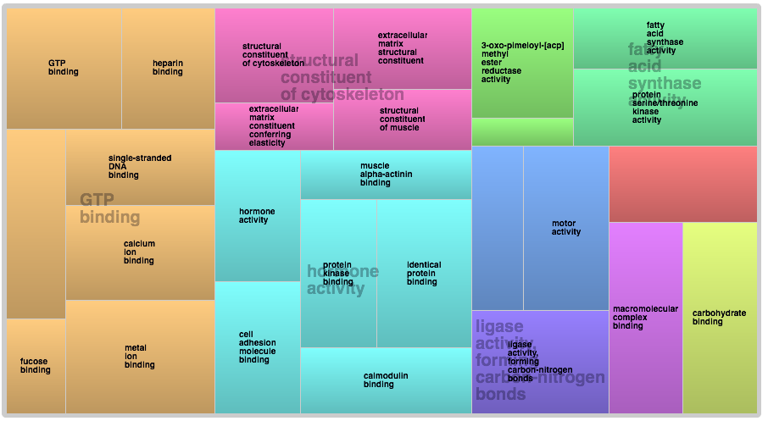
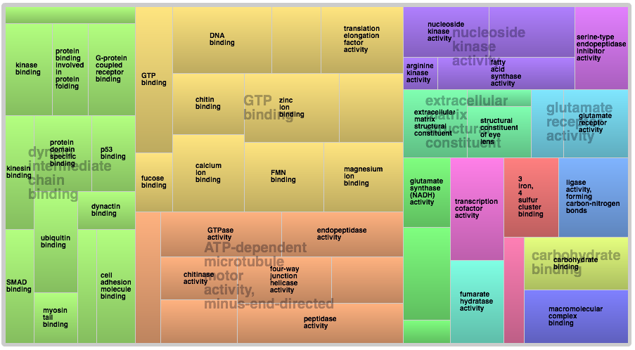
GO analysis on proteins with
Day 3
23 C
29 C
Biological processes
Biological processes
Molecular functions
Molecular functions

Slide 14
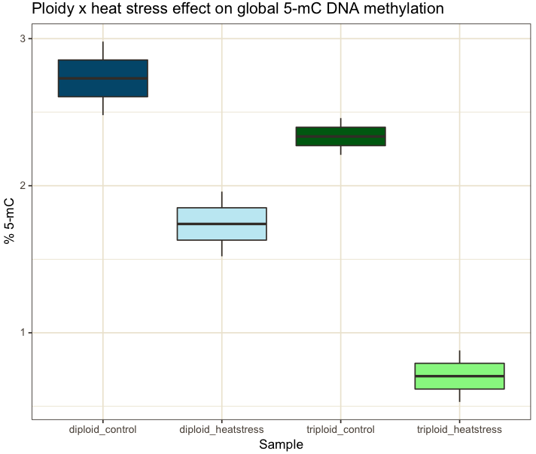
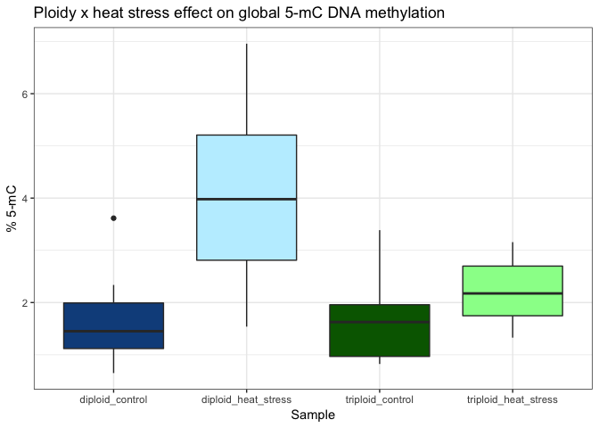

Slide 15
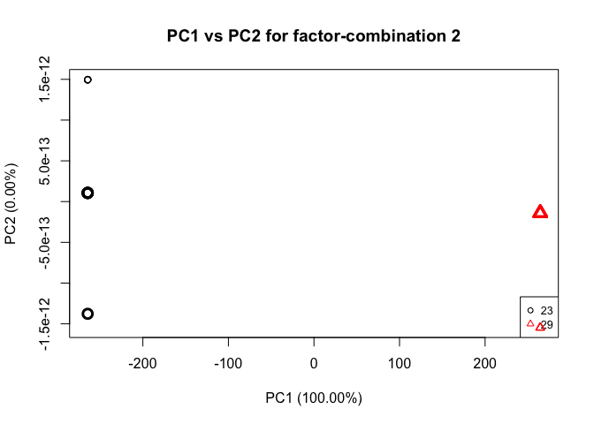
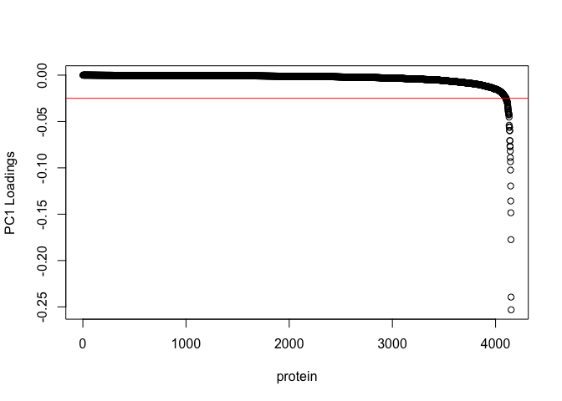
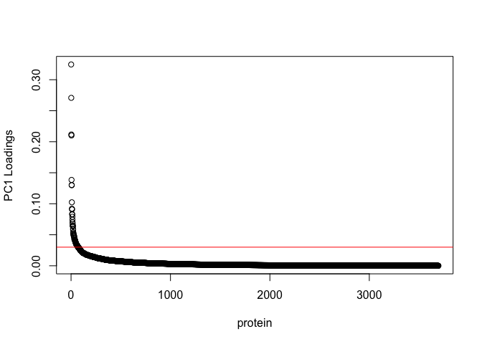
a
b
c

Slide 16
a
b
screen size range (µm) | 23°C (# of seed) | 29°C (# of seed)
315-450 | 35,250 | 29,827
450-710 | 143,080 | 78,694
710-1000 | 110,000 | 136,000
1000-1320 | 8,883 | 59,220
1320-1800 | 0 | 5,248

Slide 17
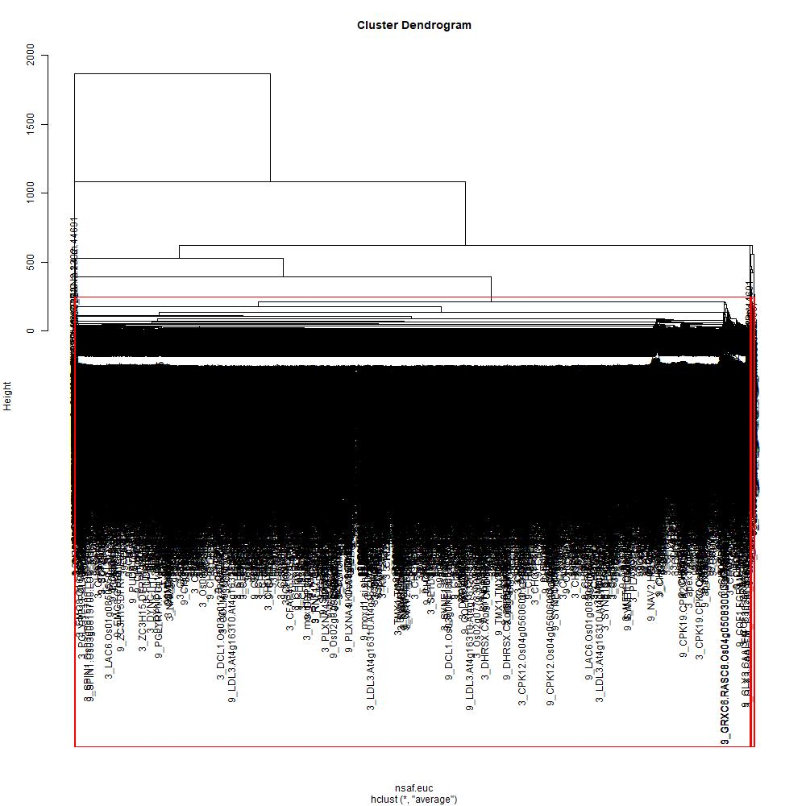
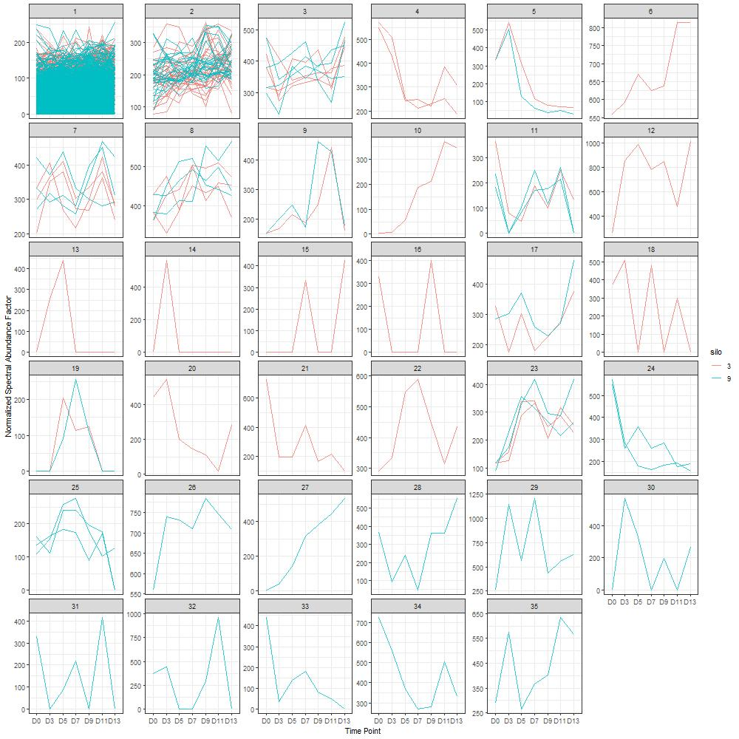
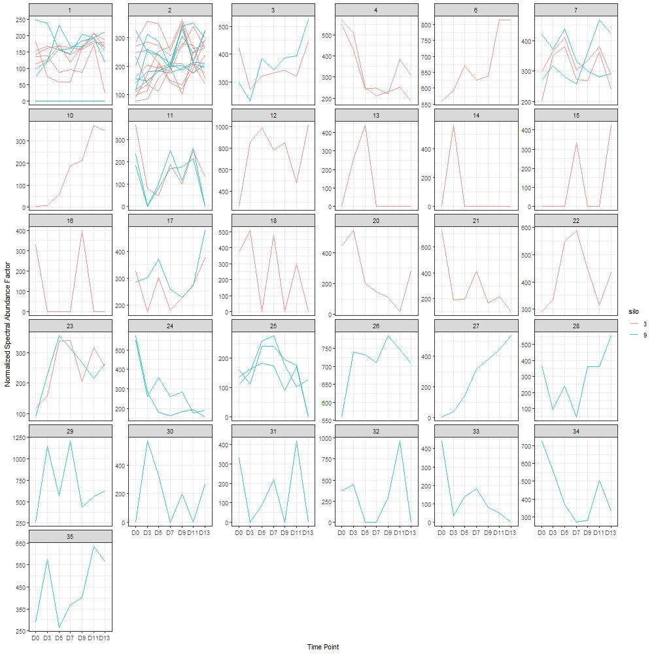
a
b
c

Slide 18
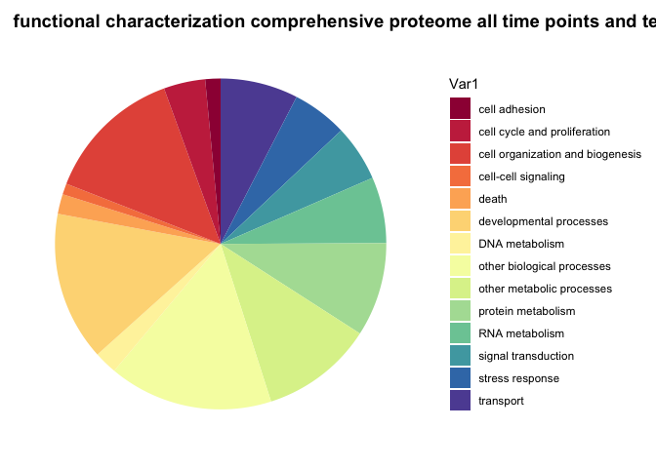
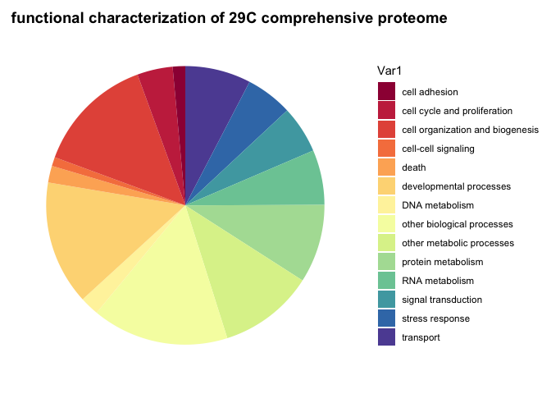
a
b

Slide 19
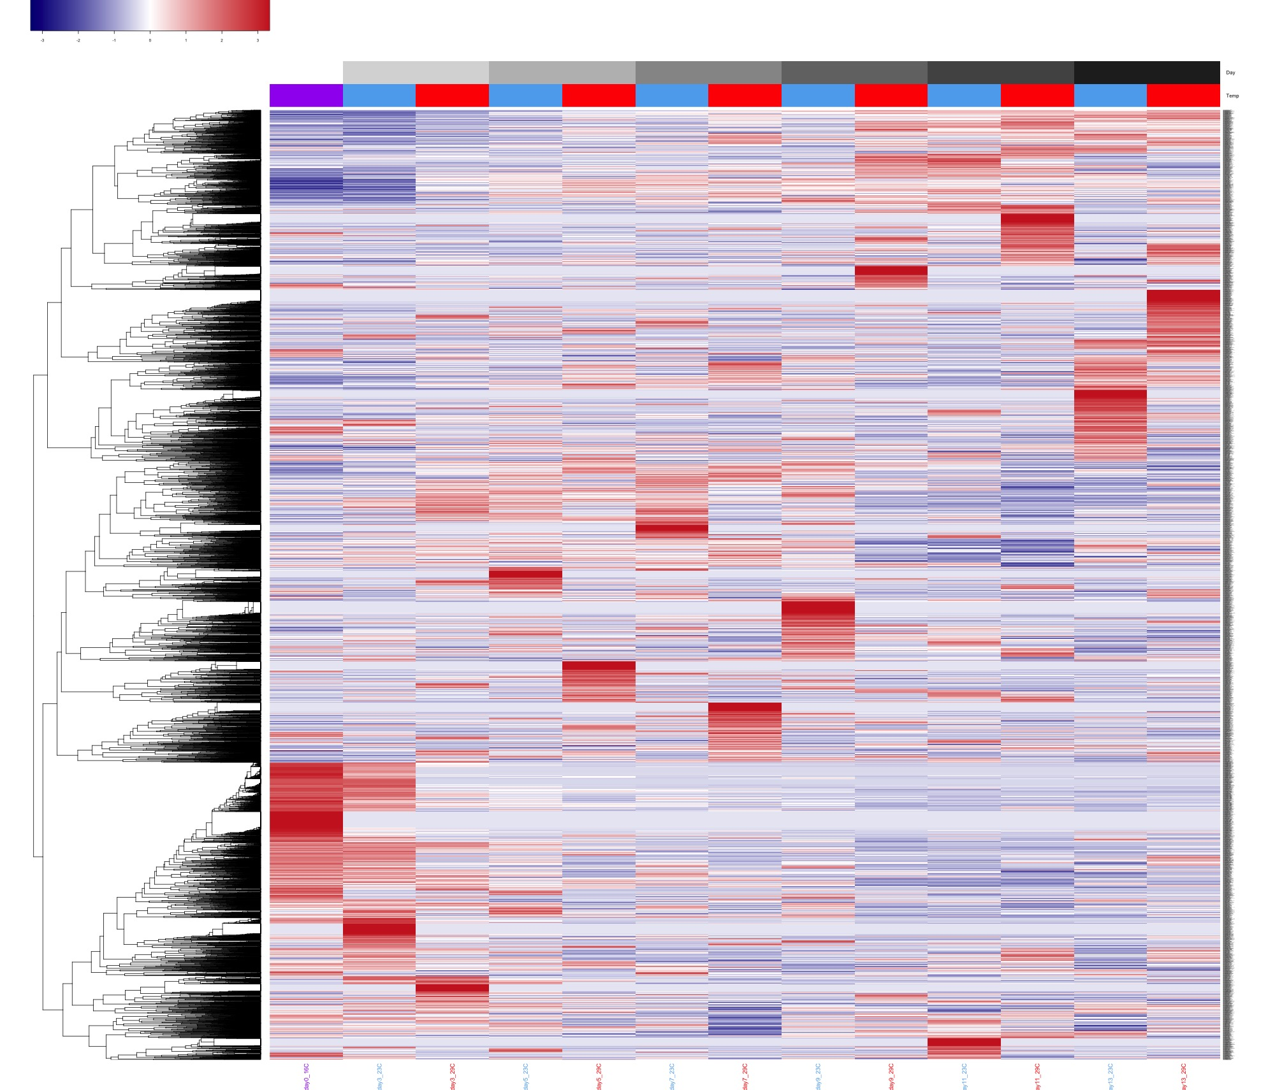
a
b
c
Notes:
Figure 2. Summary of proteomes detected across treatment groups and time points. (a) Stacked bar plot of temporal proteomes colored by rearing temperature (23C, gold; 29C, red) and showing overlapping proteins between rearing temperatures (orange). (b) PCA summary plot of proteomes colored by days post fertilization (dpf) and shapes indicating temperature (16C, circle; 23C, triangle; 29C, square). (c) Heatmap showing relative abundance (see methods) of all detected proteins with columns colored by temperature (16C, purple; 23C, blue; 29C, red) and by days post fertilization (19, white, …)
…are more in sync.
Each proteome shows subsets of proteins behaving in a time point and temperature specific manner, with high and low abundance relative to other proteomes. For instance, Day 0 and day 3 show similar patterns . Higher abundance proteins clustered together at the bottom of the heatmap…
To summarize the biology with high abundance and low abundance proteins within each proteome (see methods), we performed GO enrichment analysis and found that at day 0, proteins showing increased abundance were enriched for (biological processes) and proteins showing decreased abundance were enriched for, suggesting that at this stage… After 3 days, proteins showing increased abundance were related to … and …
Figure 4 a sideways bar plot of go terms?

Slide 20
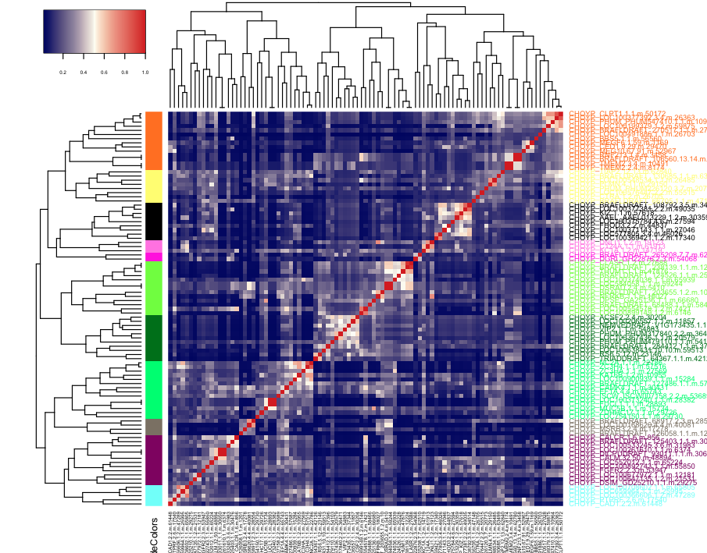
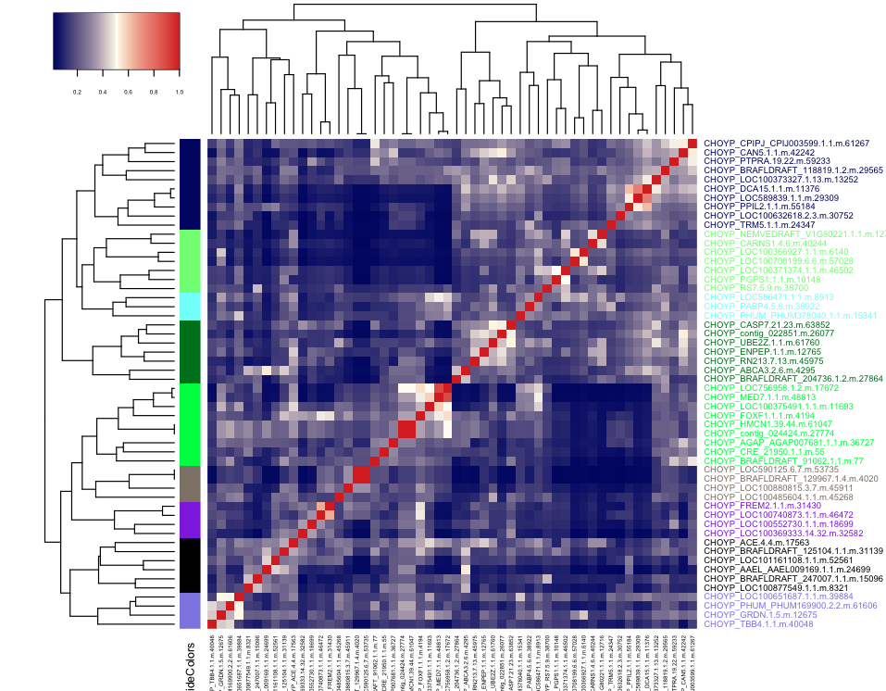
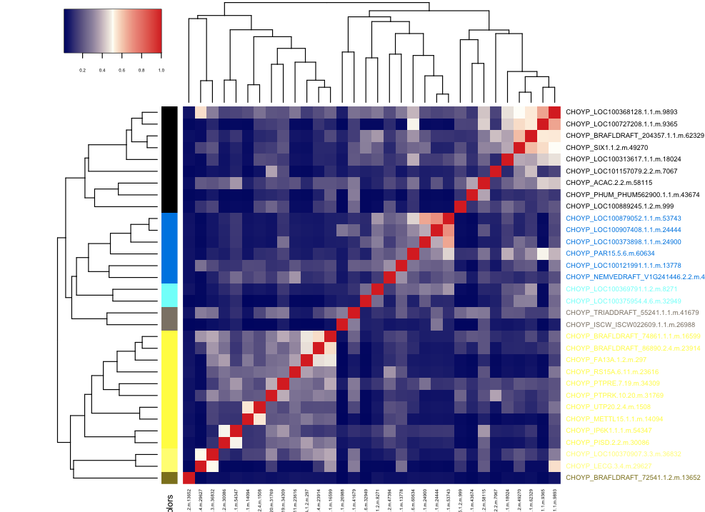
Day 0 GO sem sim for proteins > 3 in abundance
Black = cilia, cell motility
Chartreuse = defense response, immune response, RNA processing, DNA repair, viral response
Green4 = metabolic process
Notes:
Heatmap showing proteins clustered by GO semantic similarity score
Should similarity matrix be converted to dissimilarity matrix? Does this really matter?
Can calculate p-values for clusters (compared to rest of matrix)
OR JUST DO REVIGO on subsets or all day 0 up (etc)
- The purpose of this analysis is to describe what processes are occurring (based on highly expressed or lowly abundant proteins) at each different time point. Shown is for Day 0, but analysis could be done for each time point’s proteome.

Slide 21
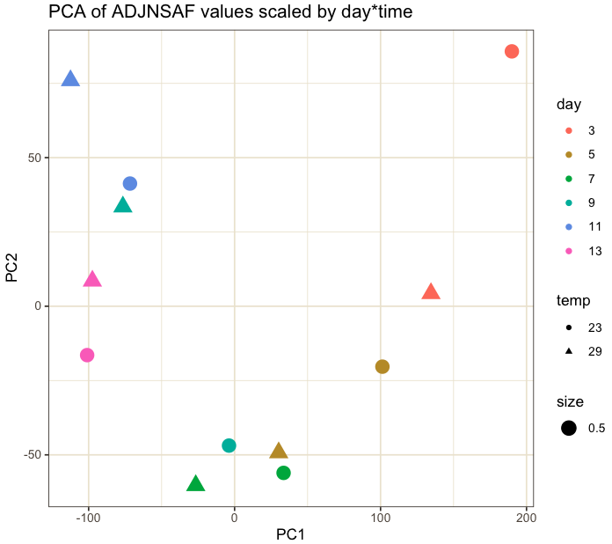
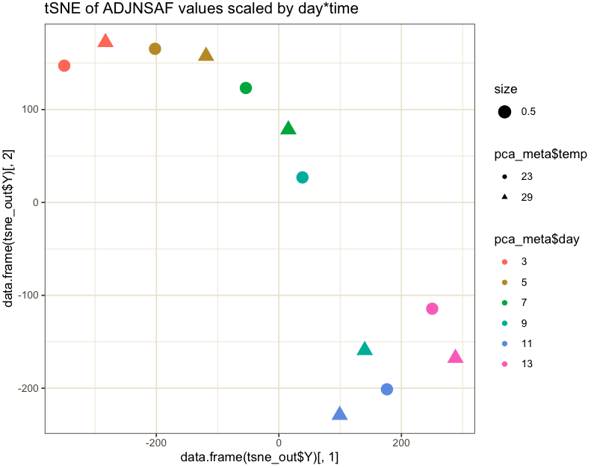
Temp x Day correction

Slide 22
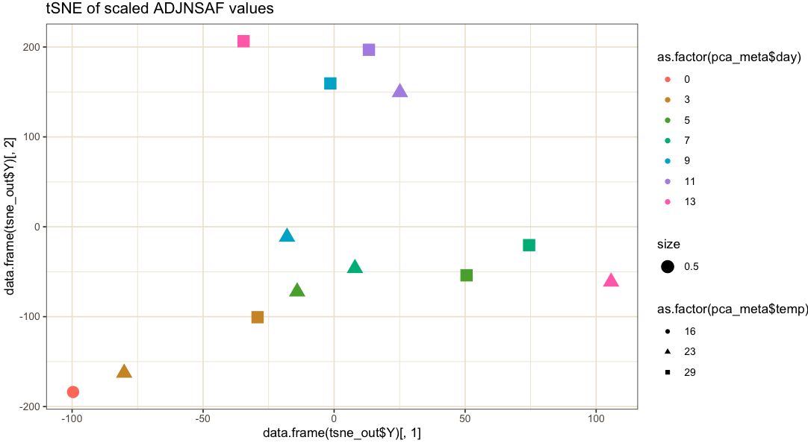
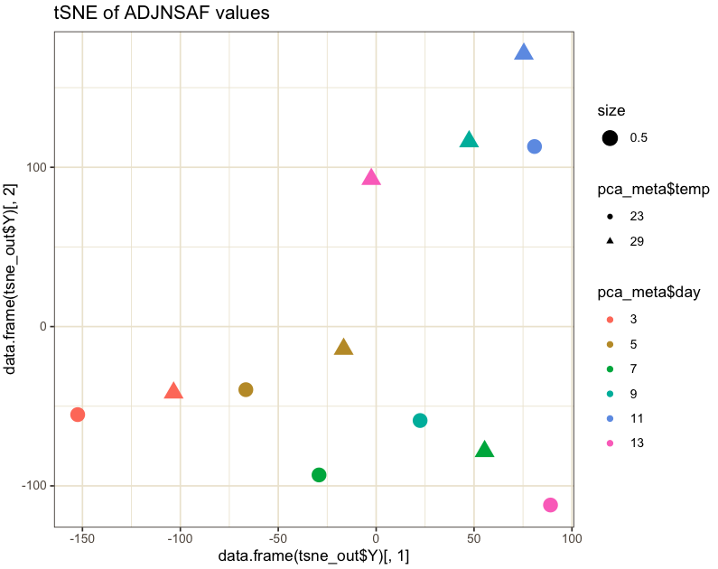
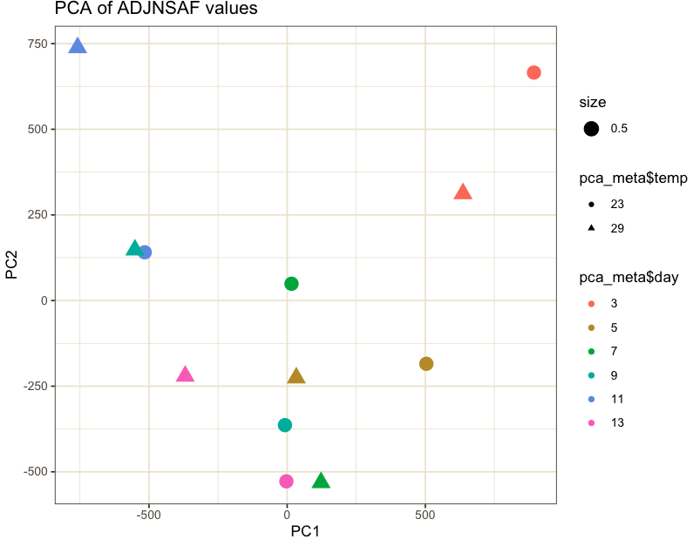





With day 0

Slide 23


dpf
19
21
23
25
27
29
31
temp. (°C)
16
23
29
With days x temp correction

Slide 24
a
b
NSAF values
(scaled by row)
3
5
7
9
11
13
3
5
7
9
11
13
23 C
29 C

Slide 25
a
b
NSAF values
(scaled by row)
-2 -1 0 1 2 3
3
5
7
9
11
13
3
5
7
9
11
13
23 C
29 C

Slide 26
Method
ASCA
ASCA_Clustering
Clustering
Proportions test
Proportions test_ASCA
All methods

Slide 27
a
b
NSAF values
(scaled by row)
3
5
7
9
11
13
3
5
7
9
11
13
Day
23 C
29 C
Temp
Proteins

Slide 28
NSAF values
(scaled by row)
a
b
3
5
7
9
11
13
3
5
7
9
11
13
Day
23 C
29 C
Temp
Proteins

Slide 29
a
b
NSAF values
(scaled by row)
3
5
7
9
11
13
3
5
7
9
11
13
Day
23 C
29 C
Temp
Proteins

Slide 30



Spectrin NSAF values
Caspase NSAF values
Calpain NSAF values

Slide 31
a
Day 3
Day 11
Day 13
b
c

Slide 32
Day 3
Day 5
Day 7
Day 9
Day 11
Day 13
a
b

Slide 33
Day 3
Day 9
Day 11
Day 13
a
Node border and fill color
0.005
0.5
10
0.58
1
2
b

Slide 34
21 dpf
23 dpf
25 dpf
27 dpf
29 dpf
31 dpf
a
b
c
d
Notes:
Node size is relative to the number of proteins associated with the term, ranging from 1 to 55. Node label size and fill color is relative to the summed magnitude foldchange of NSAF values for all proteins associated with the term and normalized to the number of proteins associated with the term, ranging from 0.005 to 10. Node border color is relative to the the summed magnitude foldchange of total number of spectra for all proteins associated with the term and normalized to the number of proteins associated with the term, ranging from 0.005 to 2.5. Edge width is relative to the GO semantic similarity score with 0.5 being the thinnest and 0.94 being the thickest.

Slide 35
= NSAF magnitude
a
b
c
d
e
f
g
h
i
j
k
l

Slide 37
TRANSPORT
DEVELOPMENT
METABOLISM
TRANSPORT
DEVELOPMENT
METABOLISM
a
a

Slide 38
TRANSPORT
DEVELOPMENT
METABOLISM
a
b
c

Slide 39

a
b

Slide 41













Slide 42
Compare network plots (Day 3 and 13)
Day 3
Day 13
Day 3
Day 13
Day 3
Day 13
Color and text size= Sum of term protein spectra/ # term proteins
Border = Sum of term protein NSAFs/ # term proteins
Size = # term proteins
Color and text size = Sum of term protein NSAFs/ # term proteins
Border = Sum of term protein spectra/ # term proteins
Size = # term proteins
Color = # term proteins (red = more)
Size and text size = Sum of term protein NSAFs/ # term proteins

Slide 43


ASCA sig. time proteins from analysis on log2 avgNSAF values
Proteins that show common changes over time across temperatures
What are they?
autoscaled NSAF

Slide 44
Temp (°C)
Temp (°C)
16
16
23
23
29
29
Time (dpf)
Time (dpf)
19
19
21
21
23
23
25
25
27
27
29
29
31
31
Clade
Clade
1
1
2
2
3
4
5

Slide 45





A
B
C
D
E

Slide 46


A
B
Temp (°C)
Temp (°C)
C
D

Slide 47

A
B

Slide 48


ASCA Sig. temp proteins from analysis on log2 avgNSAF values for silos 3 and 9
Analysis in ASCA R project 9/13/19

Slide 49



ASCA Sig. temp proteins from analysis on log2 avgNSAF values for silos 2 and 3
Down-regulated process (clade 1):
Up-regulated process (clade 2):

Slide 50

Results: biological processes enriched at 29C
clade 1
clade 2
Up-regulated processes:
Down-regulated processes:

Slide 51


ASCA Sig. temp proteins from analysis on log2 avgNSAF values for all silos
All silos
All silos (I don’t think this is as helpful

Slide 52
A
B
C
D
E
F

Slide 54
A
B
Temp (°C)
Time (dpf)
C
Temp (°C)
autoscaled NSAF values

Slide 55
A
B
Temp (°C)
Time (dpf)
C
autoscaled NSAF values

Slide 56
GO enrichment Sept 2019
BLAST to Uniprot to get GO IDs for each protein
make list of significantly different proteins and their GO IDs
make list of universe proteins and their GO IDs (significant proteins are also part of this list)
Compute fisher’s exact test for each GO ID to see if the proportion of significant proteins annotated to a GO ID is significantly different (aka enriched) than the proportion of universe proteins annotated to a GO ID
For significantly enriched proteins, compute GO semantic similarity
Plot similarity scores as heatmap to identify clades of similar GO terms

Slide 57
GO enrichment Oct 2019
BLAST to Uniprot to get GO IDs for each protein
Use topGO to calculate weight01 fisher test for each clade terms vs. all proteins ID’d in both silos
Subset results for terms that are present in the background in >=5 genes and with p-value 0.05 (liew paper)
Get GO Slim terms for all sig. terms
Plot # of sig. terms/go slim term/each clade as heatmap

Slide 58
1 2 3 4 5
number of significantly enriched GO terms

Slide 59
1 2
number of significantly enriched GO terms

